Slide 1
CAPSTONE PROJECT
MACHINE LEARNING MODEL TO PREDICT CAR PRICE USING GRADIENT BOOSTING

Slide 2
Team Members
Name | Responsibilities | Enrollment No.
Aman Khandelwal | Deployment of Model | U101116FCS007
Chinju Mary George | Data Modeling | U101116FCS025
Shashwat Shah | Data Exploration and Visualization | U101116FCS112
Sagnik Mitra | Data preprocessing and cleaning | U101116FCS188

Slide 3
RATIONALE OF WORK
Sales production is the current numerous trend in which all the business companies thrive.
This project has a wide scope in automobile industry in helping customers to know the prices of their desired cars.
It also aids the organization or concern in determining the future goals for it and its plans and procedures to achieve it.

Slide 4
OBJECTIVE
The aim of this project is to build and deploy a Machine Learning model that can predict the car price based on its features.

Slide 5
TOOLS USED
Anaconda
Python Flask
Sklearn Library
Docker
Jenkins
Github
Heroku

Slide 6
WORKFLOW
Setting the research goal & Retrieving Data
05
Model Deployment
01
04
Model Development
Data Processing and Cleaning
02
03
Data Exploration and Visualization

Slide 7
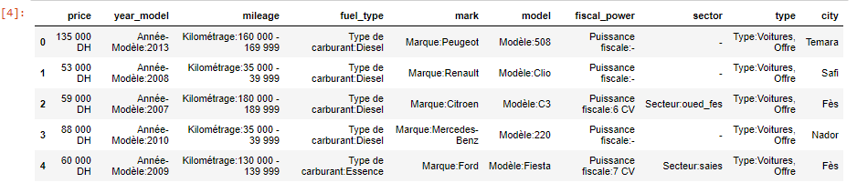
RECAP
DATA PREPROCESSING AND CLEANSING

Slide 8
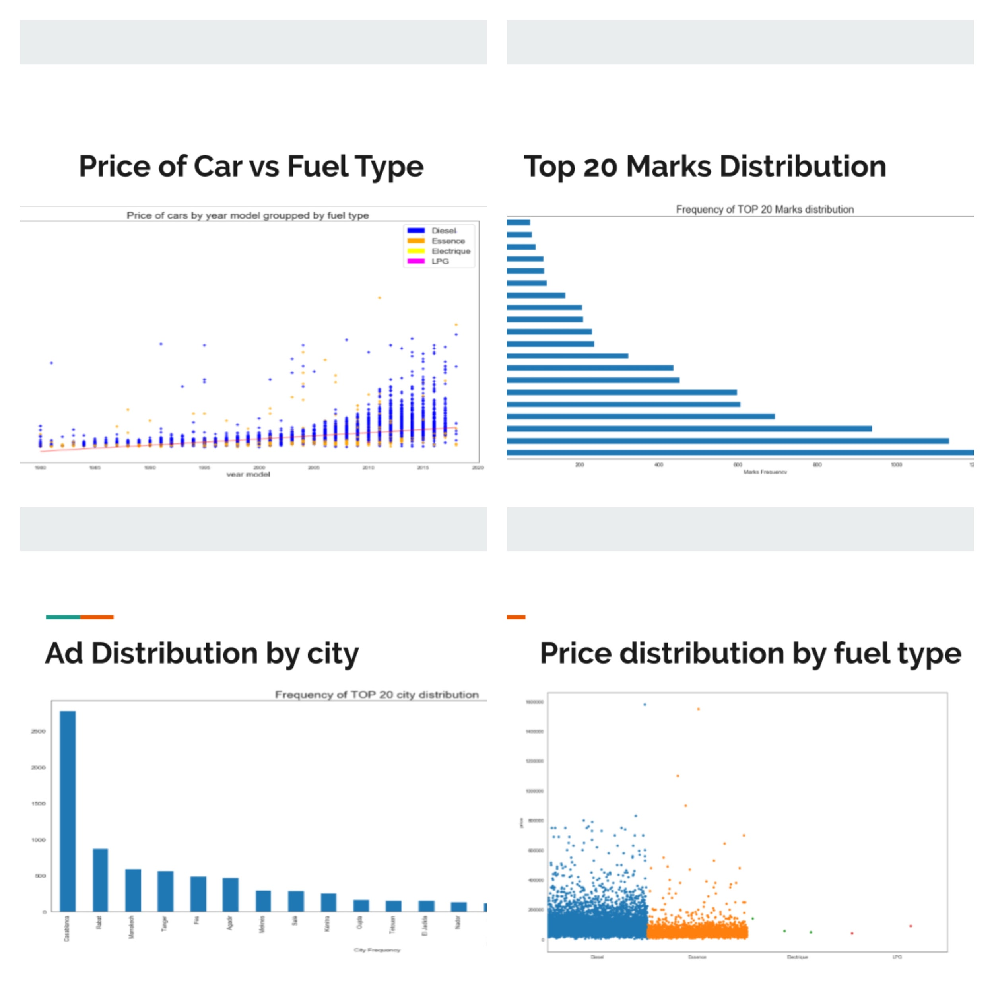
Data analysis and visualization

Slide 9
Data Modeling
Gradient Boosting
Variance Score-0.80
RMSE-25176.10
Multiple Linear Regression
Variance Score-0.62
RMSE-34865.07
Decision tree Regression
Variance Score-0.63
RMSE-34551.17
KNN Regression
Variance Score-0.58
RMSE-37709.67

Slide 10
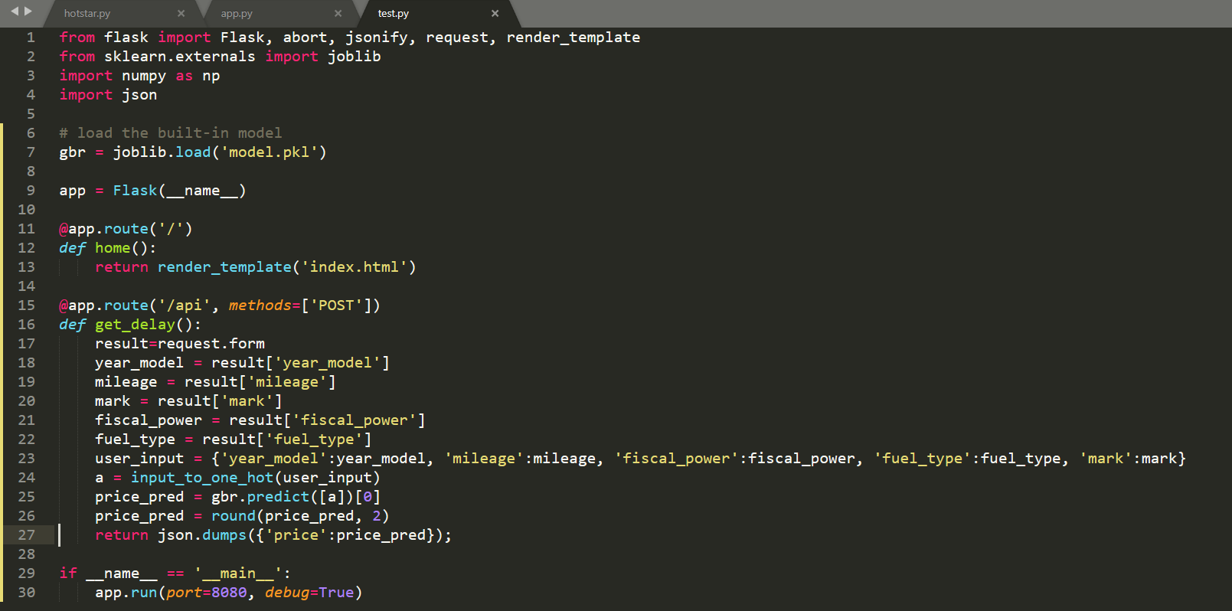
Model DEVELOPMENT
Creating the Flask web app:
Flask is a “micro” framework for Python. It is called a micro framework because they want to keep the core simple but expandable.
Our application is running on the route as :http://localhost:8080/ , then we can fill the given form with the right values and get the result as a sweet alert pop-up.
Snapshot of Flask app.py file

Slide 11
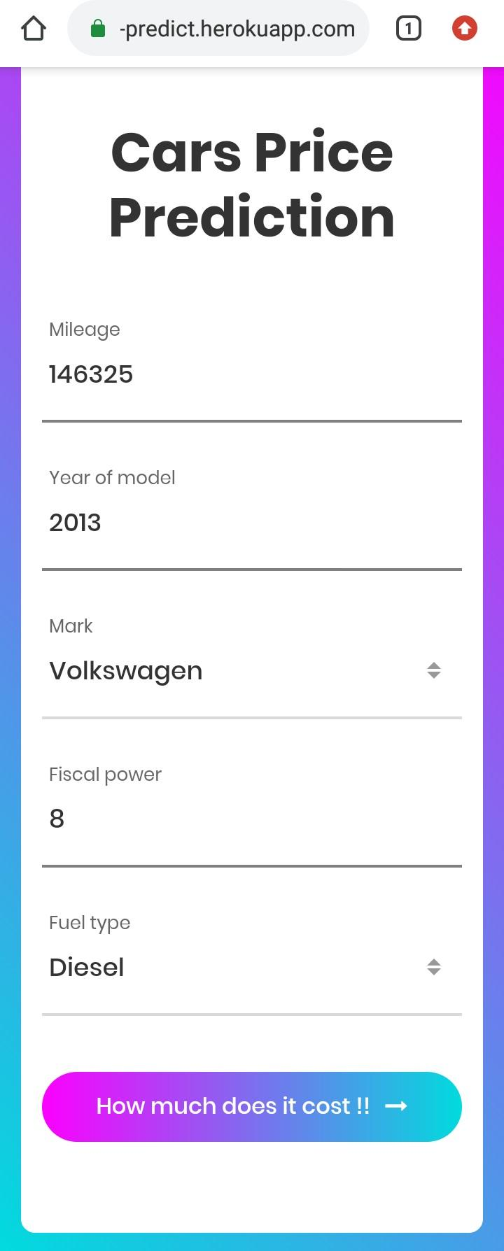
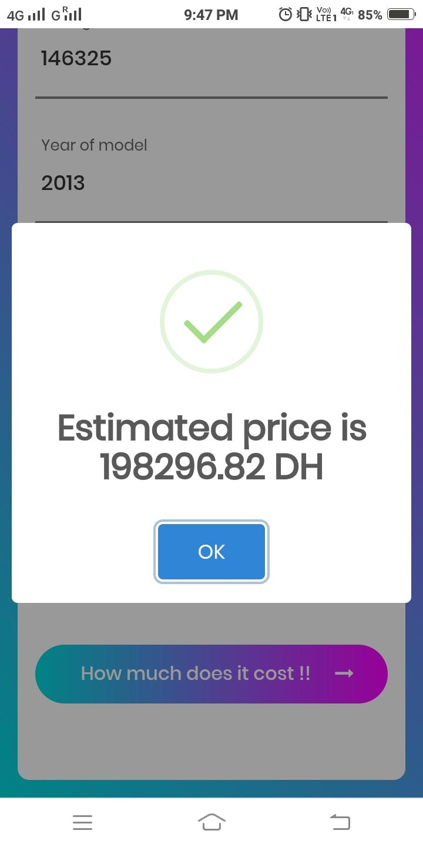
Web App
The model was created using Flask web app and deployed to Heroku.

Slide 12
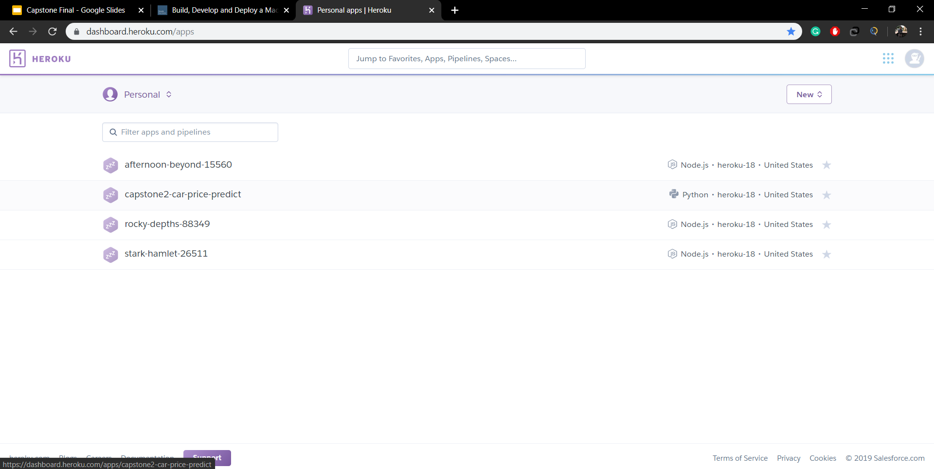
Model Deployment
For Model deployment we use Heroku.It is used to deploy, manage, and scale modern apps.
Heroku Dashboard

Slide 13
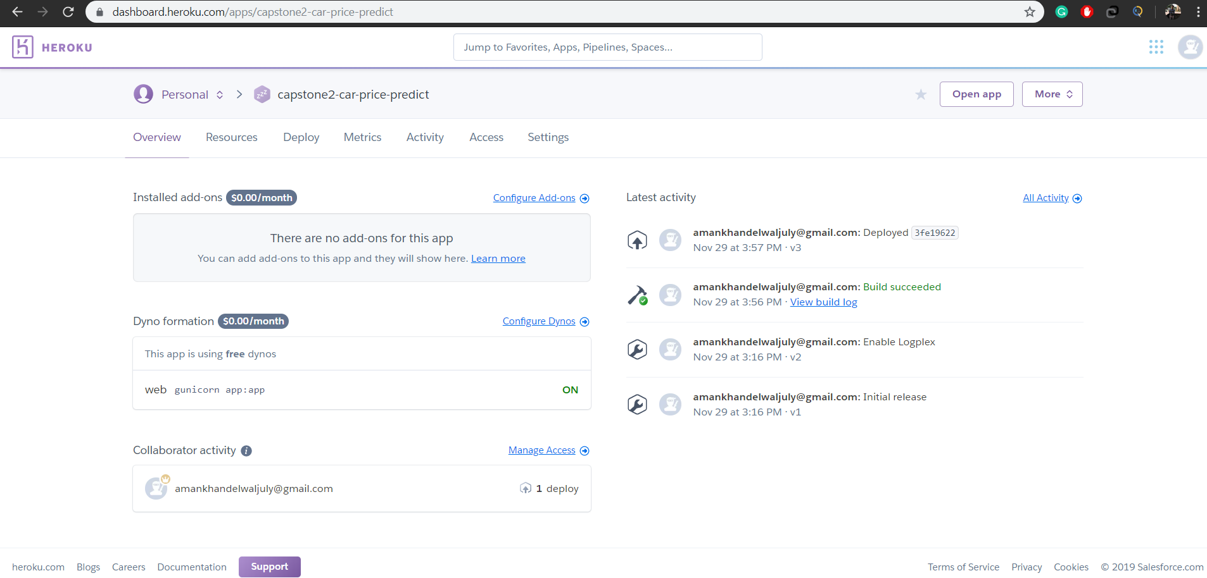
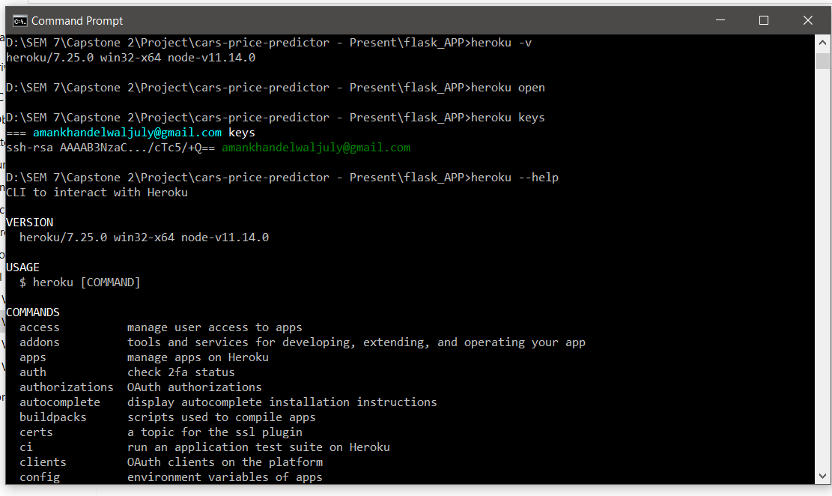
Heroku Snapshots
Heroku CLI
Application Dashboard

Slide 14
How Our MODEL WoRKS?

Slide 15
Difficulties faced
Handling large datasets increase the time to execute the task
Datasets with preferred parameters weren’t available for our data models, like, data categorized by cities since each city has different rates
Since we experimented with 4 different models, it was quite difficult to pick the one suited for our project

Slide 16
To Visit our application follow the link below
https://capstone2-car-price-predict.herokuapp.com/

Slide 17
Thank you

